Slide 1

TITLE
01 / 25
BASED Resilience
The trusted operating layer for resilience-era decision-makers.
Human-reviewed intelligence rooms, watchdesks and curated access for leaders navigating security, infrastructure, climate, capital and public-sector volatility.
INVESTOR PACKAGE UPDATE

Slide 2

CONTENTS
02 / 25
Table of contents
Context · Munich proof · Product architecture · Business model · Operating system · Diligence & ask.
01 CONTEXT
02 BUSINESS MODEL
03 OPERATING SYSTEM
04 DILIGENCE & ASK
Why now, market logic, Munich proof
Trust-led GTM, recurring model, forecast bridge
Asset-light scale, secure AI, moat, team
Evidence gates, use of funds, round ask

Slide 3
CONTEXT
03 / 25
CONTEXT
The world has entered a resilience era
Decision-makers need trusted orientation, not more generic events or undifferentiated information feeds.

Slide 4

WHY NOW
04 / 25
Resilience management is now a C-suite agenda
Geopolitics, security, supply fragility, public-trust erosion and leadership fatigue are operating risks.
INSTITUTIONAL
OPERATIONAL
GEOPOLITICAL
Public trust, regulation and leadership fatigue have become operating risks, not soft topics.
Supply, cyber and information shocks demand structured intelligence and trusted access.
Persistent conflict and security pressure shape board agendas, capital allocation and public engagement.

Slide 5
PROBLEM
05 / 25
Decision-makers do not need more noise
The gap is trusted access, context, review and decision workflow.
LOW SIGNAL
TRUST GAP
FRAGMENTATION
Generic subscriptions and events fail to convert noise into decision advantage.
Leaders pay for curated environments and credible peers, not more aggregated content.
Relationships across technology, industry, investors and public-sector stakeholders sit in disconnected pockets.

Slide 6


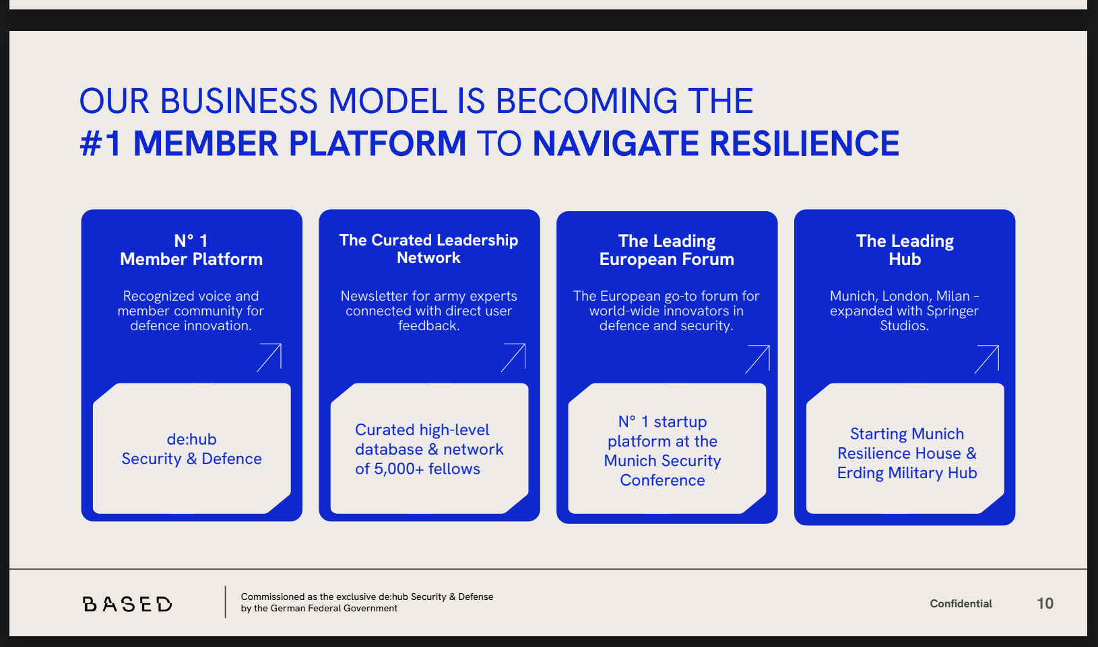
MARKET LOGIC
06 / 25
Layered convergence, not a flat category box
BASED sits across executive education, security/resilience, premium communities, intelligence subscriptions and expert networks.
UNFAIR ADVANTAGE
POOL 1
POOL 2
POOL 3
Trust wedge
Premium
Security
Experts
Official mandate + Munich access + human-reviewed AI workflow.
Executive communities and intelligence subscriptions.
Defence, geopolitics and resilience advisory budgets.
Curated expert and decision-support spend.
Notes:
Istg dxaxs nicht zu abstrakt : Sollten wir konkreter darstellen

Slide 7

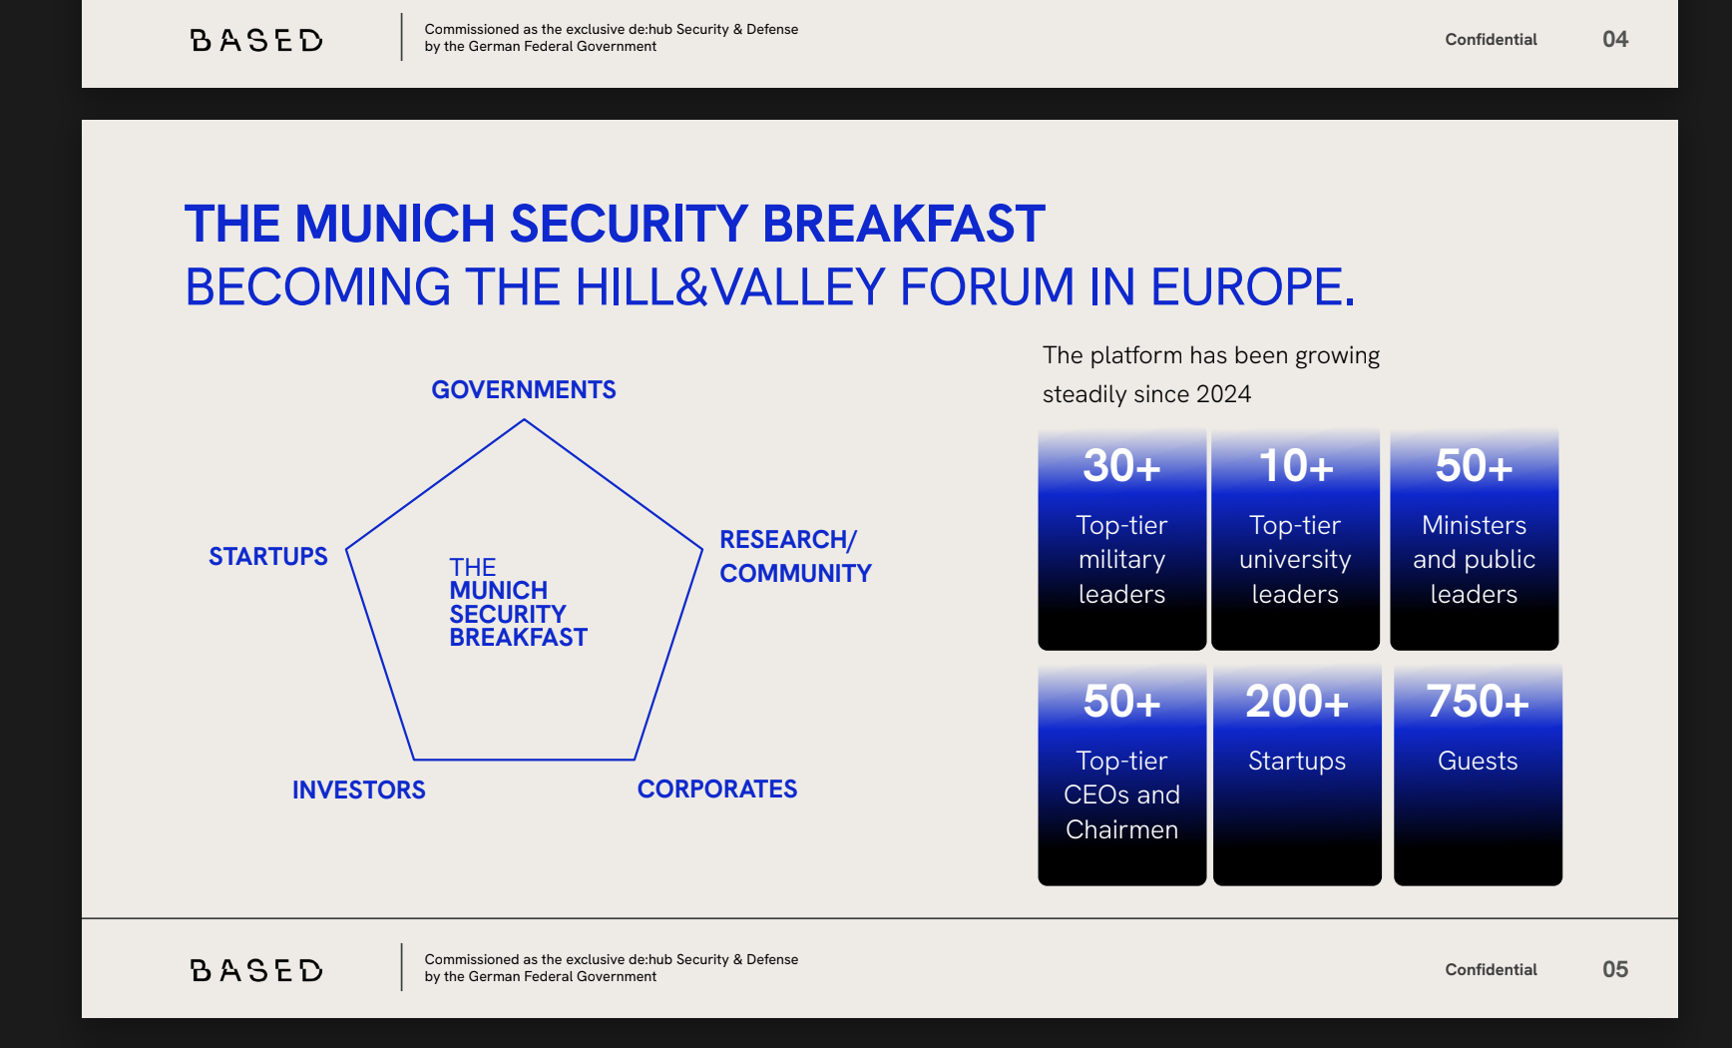
MUNICH BREAKFAST
07 / 25
Munich is the proof engine, not a side note
Latest working update: overbooking, partner interest and sponsor/service activity indicate demand, while invoices and BOM remain the proof gate.
DELIVERED SIGNAL
PROOF GATE
PRODUCT CONVERSION
Breakfast demand and partner engagement show appetite for curated high-trust formats.
Sponsor revenue validates demand only after invoice-backed package BOM and pricing tie-out.
Formats turn into source index, persona graph, watchdesk and controlled data-room workflows.

Slide 8



MUNICH PROOF
08 / 25
Official mandate: de:hub Security & Defense
BASED operates inside Germanys official innovation ecosystem and bridges government, industry, startups, investors and dual-use defence innovation.
MANDATE
ACCESS
CONVERSION
Official de:hub Security & Defense designation; public-mandate wording remains proof-gated.
Direct bridge across ministries, embassies, dual-use founders, industry and capital.
Convening becomes source index, persona graph, watchdesk and data-room workflow.
Contextual KPIs from de:hub / business-plan documentation remain proof-gated: official mandate, startup reach, ministry and industry access, dual-use founder funnel and stakeholder proof. Mandate creates trust; trust creates participation; participation creates proprietary signal; signal becomes reviewed member intelligence products.
EVIDENCE GATE

Slide 9

SOLUTION
09 / 25
BASED converts trust, signal and access into a platform
Membership, formats, intelligence, tech, access and optional infrastructure services form one product surface.
Domain experts curate high-density information value.
MEMBERSHIP
FORMATS
INTELLIGENCE
Premium tiers and member profiles.
Curated convening and expert circles.
Source index, heartbeats and reports.
TECH
ACCESS
INFRASTRUCTURE
The first operating ceiling is 1,000 members, including free members and the military/government quota. Paid conversion remains selective; intelligence and media products monetize the trusted signal created by membership and formats.
Secure AI rooms and persona graph.
Stakeholder and partner network.
Optional sites after proof.
Tailored, targeted dialogues
Resilience House as a selected high-security venue for vetted stakeholders.
Notes:
BE MORE SPECIFIC

Slide 10
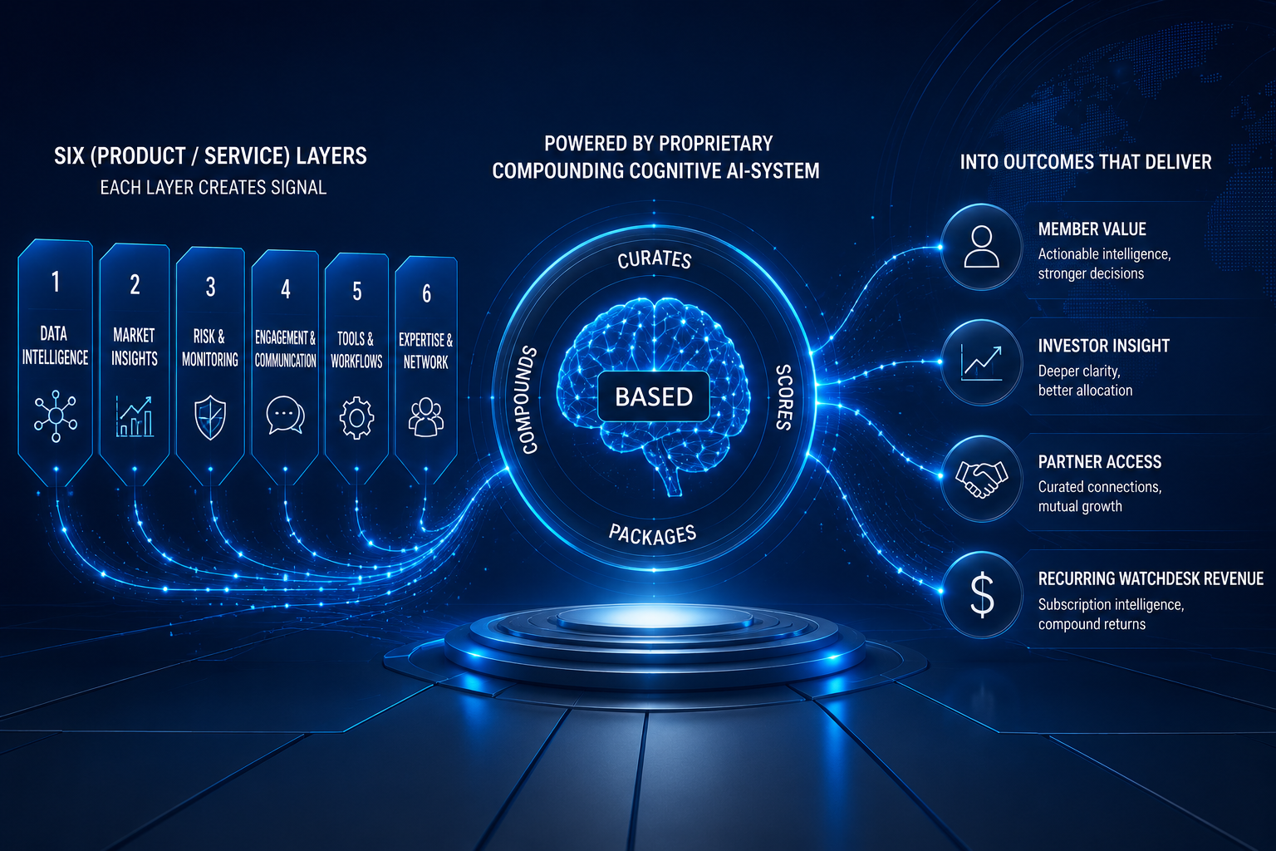
10 / 25
Six platform layers, one AI-enabled intelligence system
Each layer creates signal. The AI knowledge layer curates, scores and packages that signal into customer workflow value.
ACCESS MEMBERSHIPS
Low-touch entry plus premium member participation. Tier/package pricing confirmed: Individual EUR1,300 / Institutional EUR6,500 / Patron EUR19,000; finance-owner sign-off remains external-send gate.
SIGNAL
WORKFLOW
Membership, events and access generate proprietary context.
Human-reviewed outputs embedded in customer decisions.
AI LAYER
PRODUCTS
RAG, source index, persona graph and quality scoring.
The product stack connects source index, persona graph, controlled rooms, watchdesks, reports and human review. AI is the leverage layer behind membership, formats, intelligence products and controlled rooms.
INTELLIGENCE PRODUCTS
Member services, intelligence reports, sector briefings and controlled source rooms.
Q4 media/intelligence services start marginally in 2026 and ramp only after member cadence, source workflow and delivery capacity are proven.
SPRINTS
Diligence briefs at EUR35k keep delivery fixed-scope and reusable.

Slide 11
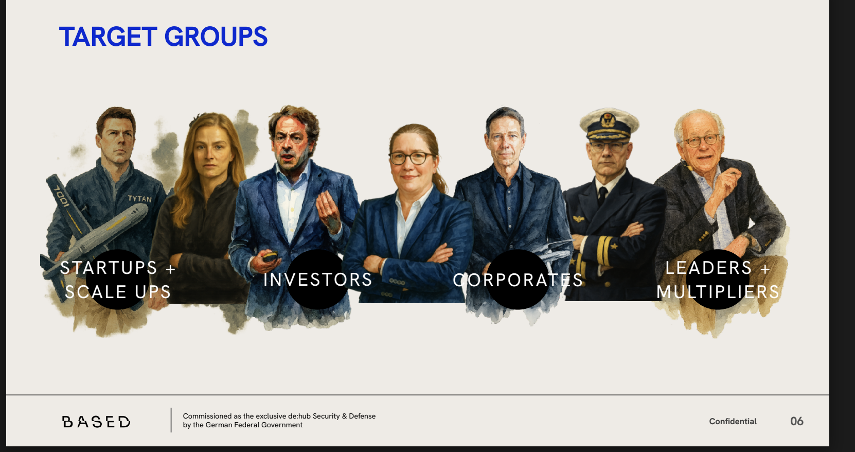
CUSTOMERS
11 / 25
Multi-tier customer approach
Separate buyer groups keep the revenue model disciplined and avoid generic community claims.
ACCESS
INTELLIGENCE
EXECUTION
MEMBERS / SPONSORS
INVESTORS / INSTITUTIONS
OPERATORS / FOUNDERS
Curated knowledge access, event intelligence, partner maps and visibility.
Membership, Q4 media/intelligence services, sector briefings and source-linked reports.
Managed watchdesks, vendor maps, training assets and execution briefings.
ACCESS MEMBERSHIPS
Low-touch entry plus premium member participation. Tier/package pricing confirmed: Individual EUR1,300 / Institutional EUR6,500 / Patron EUR19,000; finance-owner sign-off remains external-send gate.
Diligence briefs at EUR35k keep delivery fixed-scope and reusable.
Customer groups are kept distinct: members and sponsors, institutions and investors, operators and founders, public-sector/military quota, and premium intelligence buyers. Breakfast reach can feed the free pool; paid conversion stays inside the first 1,000-member ceiling.
Q4 media/intelligence services start marginally in 2026 and ramp only after member cadence, source workflow and delivery capacity are proven.

Slide 12
12 / 25
BUYER POOLS
Bounded buyer pools and ARPU bands
Paid premium memberships and premier intelligence users define the initial market logic.
PREMIUM MEMBERS
PREMIER INTELLIGENCE USERS
STRATEGIC PARTNERS
Entry-to-premium membership converts trusted access into recurring participation.
Investors, institutions and strategic operators pay for reviewed rooms and watchdesks.
Cohorts, sponsor packs and programs remain evidence-gated upside until named partners convert.
Proof-led product mix: Breakfast demand creates reach, Club converts recurring relationships, and MSB pre-sale validates willingness to pay. Selective paid conversion drives growth; premium members receive MSB access while free members remain lighter-touch.
1st breakfast
2nd breakfast
Pre-sale
3rd breakfast
--membership
Q3/Q4
extended
media services

Slide 13
13 / 25
MARKET SIZING
Not top-down TAM
The lower-case case is built from customer/unit volume x price, not a top-down market-share assumption.
2026 LOWER-CASE
2027 LOWER-CASE
2028 LOWER-CASE
EUR830k
EUR2.619m
EUR8.95m
Package-pricing active case; non-stacked.
Membership plus media; gate to named pipeline.
Gated expansion case, not historical fact.
SCB/SBR/MSB/base revenue is reference/call-gated and excluded from the active lower-case total.
Active package-pricing case: 2026 EUR830k, 2027 EUR2.619m, 2028 EUR8.95m. 2026 includes EUR530k membership revenue from 270 paid seats / 166 paid license packages inside 990 total members.

Slide 14
14 / 25
COMPETITION MATRIX
DOMAIN SPECIALISTS EVENTS COMMUNICATION LOCATION AGENCY INNOVATION
DLD / BLOOMBERG / BURDA / SPRINGER / CYBER INNOVATION HUB / EUROPEAN DEFENSE TECH HUB / POLITICO
HACKATHON
Notes:
** private initiative ; no public mandate ; try to position around defence tech

Slide 15
BUSINESS MODEL
15 / 25
BUSINESS MODEL
Trust-led GTM, recurring intelligence model
Trust earns access. Access creates signal. Signal becomes source-linked, human-reviewed intelligence products.
MSB and external formats acquire trust; Club monetizes recurring relationships; Q4 media adds a marginal 2026 revenue line; incubation remains haircut until delivery proof. Customer outputs must remain source-linked, reviewed and reusable.

Slide 16
ECONOMICS
16 / 25
Membership-led proof case plus Q4 media
Membership architecture is under active refresh; investor version should emphasize buyer jobs, price x volume logic and evidence state.
ACCESS MEMBERSHIPS
INTELLIGENCE PRODUCTS
SPRINTS
PROGRAMS
Low-touch entry plus premium member participation. Tier/package pricing confirmed: Individual EUR1,300 / Institutional EUR6,500 / Patron EUR19,000; finance-owner sign-off remains external-send gate.
Q4 media/intelligence services start marginally in 2026 and ramp only after member cadence, source workflow and delivery capacity are proven.
Diligence briefs at EUR35k keep delivery fixed-scope and reusable.
Strategic cohorts at EUR500k remain scenario until named partners convert.
2026 active economics: 990 total members, 270 paid seats / 166 paid license packages, EUR530k membership revenue, plus EUR100k media, EUR100k incubation and EUR100k event-format expansion.

Slide 17
RECURRING FIRST
17 / 25
Recurring first, scenario upside second
Membership, intelligence rooms and managed watchdesks are the predictable base. Strategic programs and Houses remain upside.
THE CORE MODEL
THE CORE LOCATION
RECURRING BASE
PREMIUM WORKFLOW
SCENARIO UPSIDE
Membership, knowledge access, briefings and source-linked updates.
High-value media/intelligence packages add upside after Q4 2026 and remain capacity-gated.
Strategic programs and Houses scale only after demand and capacity gates pass.
Digital and event services
Resilience House
as gravitation center
Scale from Munich first: prove the core model and core location, then expand. Recurring membership monetizes the relationship across 365 days; intelligence and media products follow from Q4 2026. Sponsor/member pre-sales reduce working-capital risk.

Slide 18
MODEL GATES
18 / 25
Driver model view: caveats visible
Active package-pricing model: EUR830k / EUR2.619m / EUR8.95m, non-stacked and proof-gated.
MEMBERSHIP
INCUBATION
2026/2027 cap: 990 / 1,000 total members; paid seats 270 / 480; 2026 paid license packages 166; evidence state required.
Strategic programs remain marginal in 2026/2027 and are capped at <=0.2x legacy plan until named partners convert.
Investor reliance requires buyer, product, unit, price and evidence state to remain visible.
Recalibrated cap logic: 2026 = 990 total members including 620 free, 100 military/government and 270 paid seats; 2027 = 1,000 total members including 480 paid seats. Each case shows category, seats, price, conversion assumption and evidence state.

Slide 19
PLATFORM GROWTH
19 / 25
Product-level revenue forecast
Main deck uses the lower proof-case path; legacy high scenarios stay in diligence context.
2025 ACTUAL
2026
2027
2028
EUR245k
EUR830k
EUR2.619m
EUR8.95m
Source-backed historical revenue.
Package-pricing active case.
Membership plus media; named-pipeline gate.
Gated expansion case.
2025 MSB revenue: EUR140k. Breakfast/sponsor activity validates demand only after invoice-backed package BOM and pricing logic.
Active package-pricing path: 2025 actual EUR245k; 2026 EUR830k; 2027 EUR2.619m; 2028 EUR8.95m. Prior EUR2m/EUR6m/EUR18m and EUR1.2m/EUR3.746m/EUR11.97m paths are audit bridge only.

Slide 20
OPERATING SYSTEM
20 / 25
OPERATING SYSTEM
The operating system is the company
Compounding knowledge infrastructure and proof-gated workflows create operating leverage.
Target-state organization: founder-led today, then 6-9 month buildout across operations, content/research, community, fellowship, finance/admin, advisors and tech/product support.

Slide 21
MOAT
21 / 25
Curated trust plus compounding knowledge infrastructure
Moat compounds through relationship density, proprietary signal, knowledge memory and customer workflow lock-in.
TRUST
SIGNAL
High-ROI
WORKFLOW
Decision-maker relationships and convening credibility.
Each member cycle, event and briefing creates source-linked intelligence.
Human-reviewed scoring filters what becomes customer-facing.
Rooms, watchdesks and graphs embed into decision rhythms.
Flywheel: trust -> access -> proprietary signal -> HROI intelligence -> customer workflow -> more trust.
Moat combines physical trust density with knowledge infrastructure: curated rooms create proprietary signal; source-linked memory turns signal into reusable workflow value.
Resilience House is the carrier of the knowledge infrastructure, but hard capex follows utilization and paid-conversion proof.

Slide 22

SECURE AI
22 / 25
Secure Semantic Intelligence Operations is the leverage layer
The claim is controlled intelligence: source-linked, human-reviewed, gated and audit-traceable.
SOURCE INDEX
PERSONA GRAPH
CONTROLLED ROOMS
Every promoted source is reviewed for provenance, credibility, actionability and access.
Relationships and decision contexts become reusable knowledge memory.
Customers see reviewed outputs, not raw unvetted AI tooling.
Secure Semantic Intelligence Operations: source-linked, human-reviewed, controlled rooms, persona graph and RAG-enabled reporting. AI language is used only where it reinforces trust, auditability and workflow value.

Slide 23

ASSET LIGHT
23 / 25
Resilience House: capex follows proof
The facility matters because it concentrates trust, programming and partner demand, but the plan stays asset-light until utilization is proven.
FACILITY BENEFIT
EXISTING DEMAND
Accredited high-security venue vetted by government, military and institutional stakeholders.
A physical anchor can make the trust layer tangible: convening, partner visibility, proof rooms and community cadence.
Latest management update points to overbooking and partner interest; investor claim remains evidence-gated.
Use partner venues first; add hard infrastructure only where customer proof demands it.
Asset-light path: use partner venues and external formats first; commit hard infrastructure only after member economics, utilization and repeatable demand prove out.
High-security venue need is strategically real, but investor case should show staged proof before capex.
Resilience House as gravitational center

Slide 24
ROUND ASK
24 / 25
EUR1m pre-seed to convert trusted access into paid intelligence workflows
This round funds source-linked product usage, paid pilots, repeatable conversion and clean evidence gates.
EUR530k membership revenue from 166 paid license packages.
PROOF
Paying seats
GATE
ASK
RUNWAY
Non-stacked
EUR1.0m
12-18 months
EUR830k active 2026 proof case.
EUR1m funds proof, not passive burn: membership conversion, content/research ops, source index, persona graph, controlled rooms, pilot delivery and Breakfast/Bits working-capital bridge. Working capital closes the short cash gap between credible venues/formats and sponsor/member pre-sales; sell-out velocity, deposits and downside timing remain gates.
SAFE-first; final terms counsel/investor-review gated.
3-5 pilots
Fixed burn stays lean; delivery scales with signed revenue.
Membership, Q4 media and event-format economics validated.

Slide 25
CLOSE
25 / 25
BASED is the trusted wedge. The investment case is turning that wedge into workflow.
Not another event brand or generic AI feed: a human-reviewed intelligence layer built from access others cannot quickly replicate.
ALREADY PRESENT
NOW BEING BUILT
INVESTOR UPSIDE
Mandate, Munich access, defence innovation relationships and sponsor demand signals.
Source index, intelligence rooms, persona graph, watchdesks and controlled data-room workflows.
Recurring premium intelligence workflows before resilience becomes a crowded boardroom category.
Ask: back the proof plan, pressure-test the gates, and help BASED turn trusted access into the resilience intelligence layer.

